Slide 1





Road Sign and Road State Mobile Notification Application
TASK V: UI DESIGN AND IMPLEMENTATION

Slide 2
Table of contents
01
03
02
04
Introduction
Implementation
UI Design
Conclusion

Slide 3


01
Introduction
To create a successful mobile app, we followed a design process that involved research, wireframing, and prototyping.

Slide 4
02
UI DESIGN

Slide 5
The UI design prioritizes clarity, ease-of-use, and minimal distraction for drivers. Key interfaces include:
1.1
User Registration and Authentication
Reports
1.4
1.2
Dashboard
1.5
Notifications
Map View
1.6
Settings
1.3

Slide 6
2.1
Screens
User Registration and Authentication
Sign-Up
Log-In
Allows new users to create an account with the application.
Involves collecting user information like email address, username, and password.
Enables existing users to access their accounts after signing up.
Provides a secure way to manage user sessions and access control within the application.

Slide 7
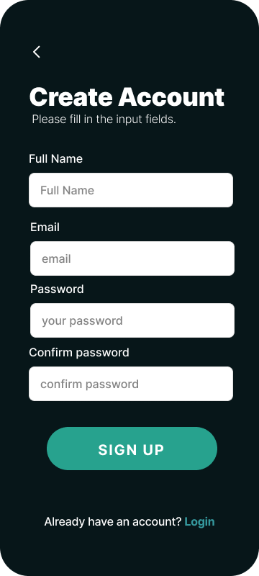
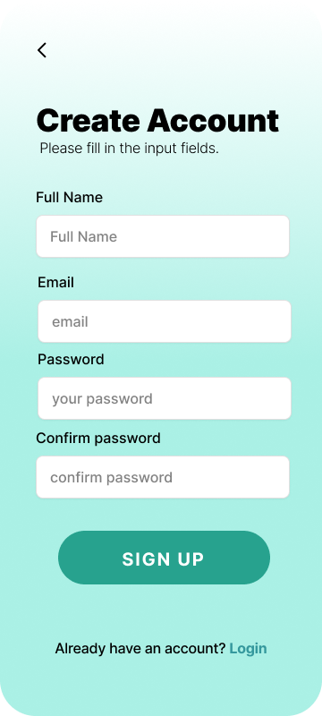

Slide 8
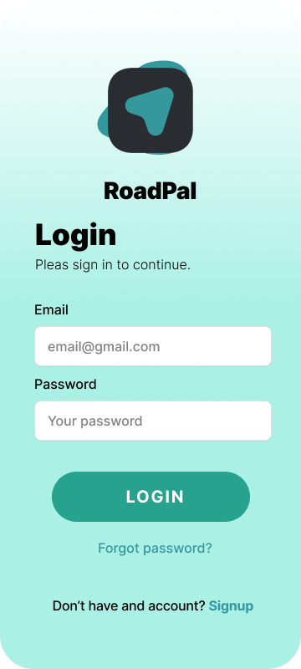
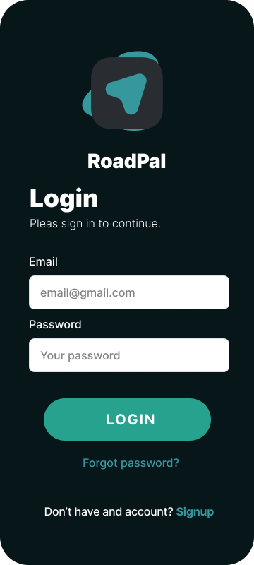

Slide 9
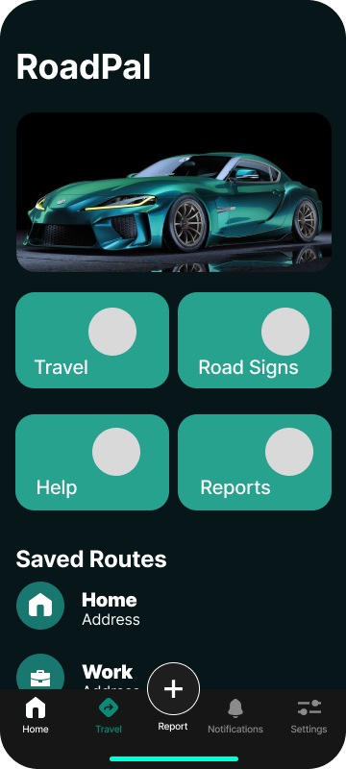
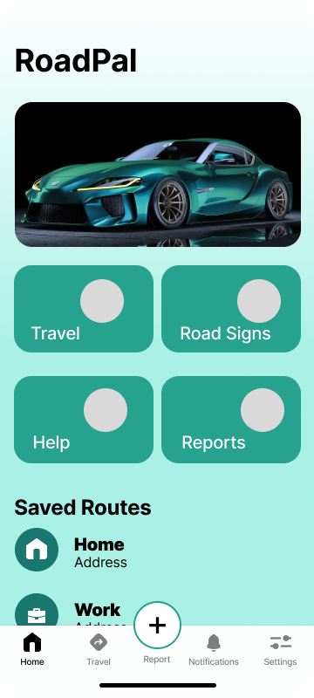
Dashboard
Travel
Help
Road Signs
Reports

Slide 10
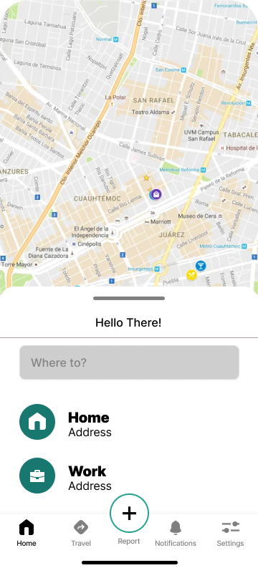
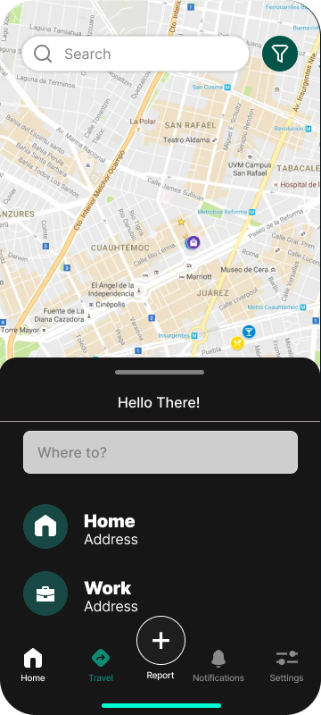
Map Views
User sets a destination and a mapped route is displayed for him/her.

Slide 11
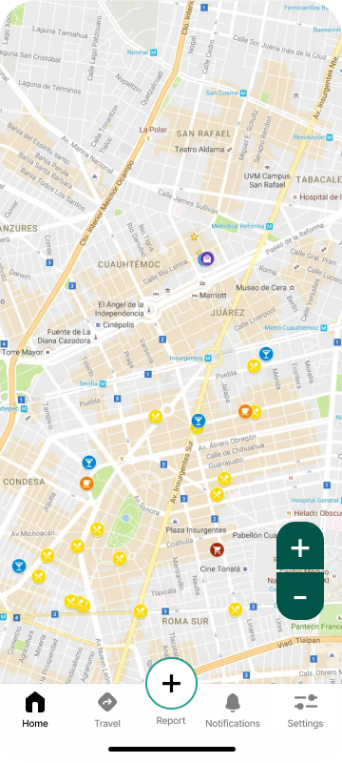
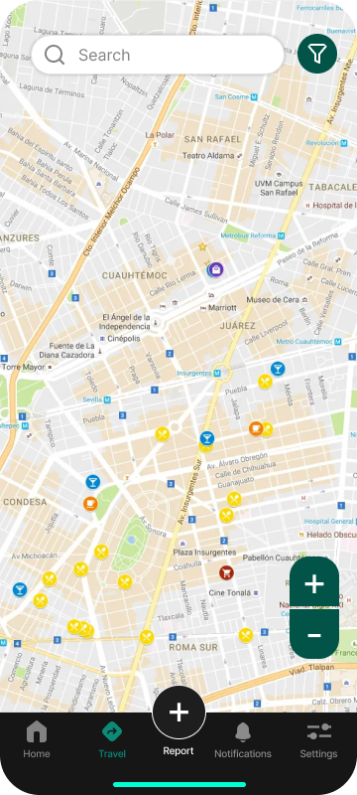
Full view of the map once route has been chosen.

Slide 12
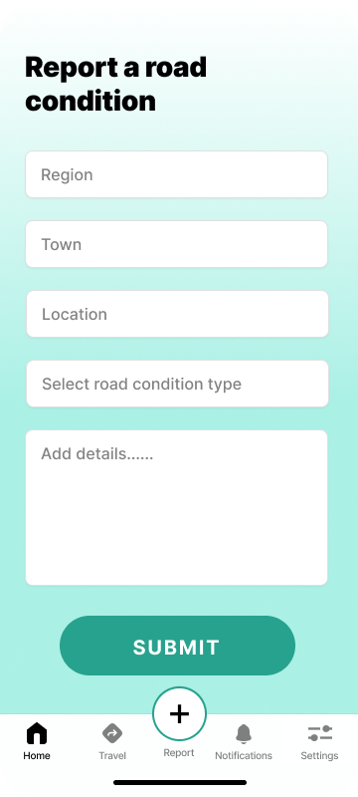
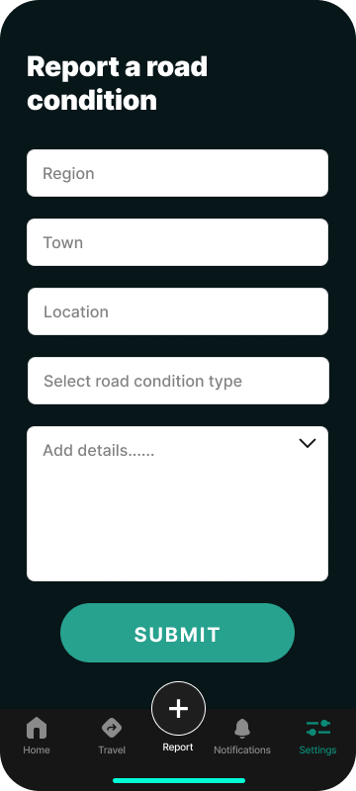
Report
Report sign detection errors
Suggest Missing Signs
Provide Feedback

Slide 13
Notification
Method of notification
Type of notification
Displaying Text Notifications
Playing Audio Notifications
Notify drivers of road signs
Inform Drivers of Accidents
Alert Users about Traffic Congestion
Provide Updates on Weather Conditions

Slide 14
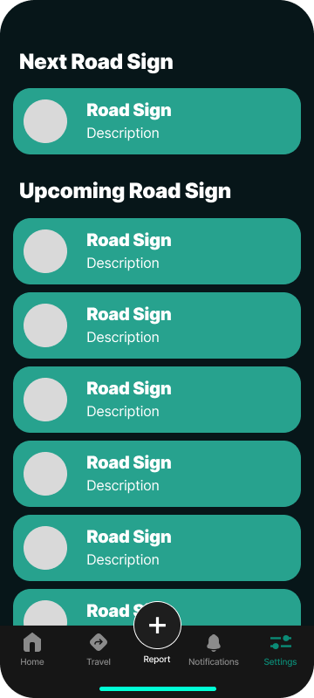
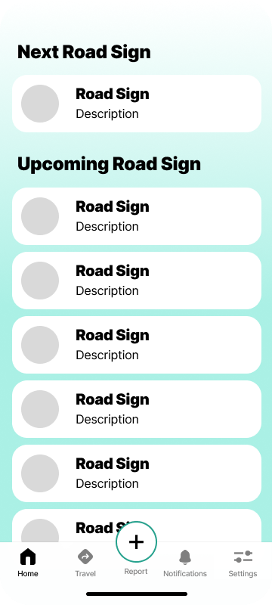

Slide 15
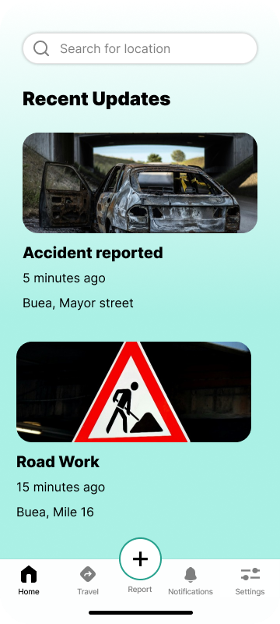
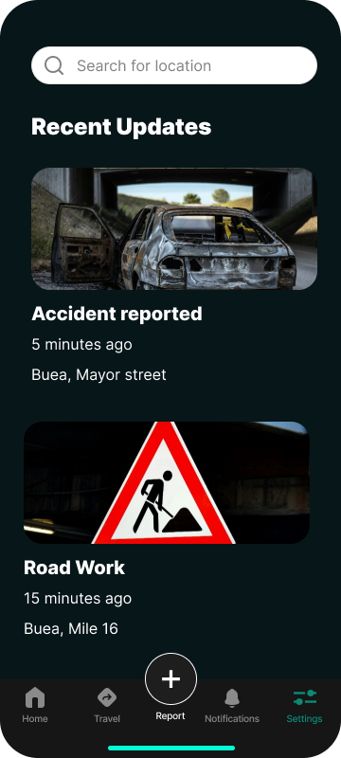
Recent Updates
Provides the user with recent information about reported data and app developments and upgrades.

Slide 16
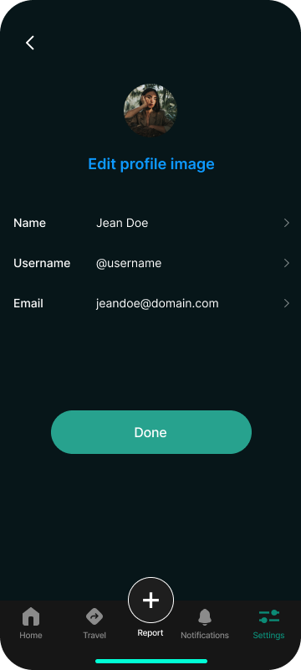
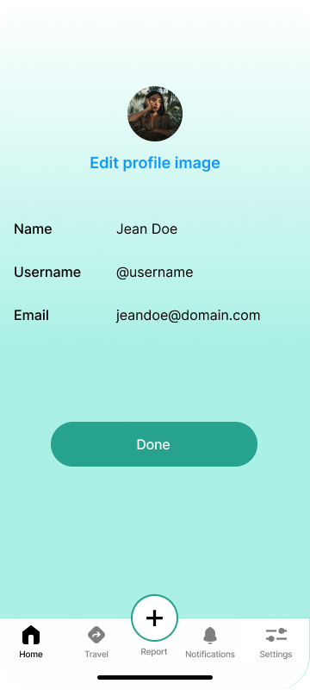
Settings
Here, users are, able to edit their profile (information about them which the application stores) as well as their preferences.

Slide 17
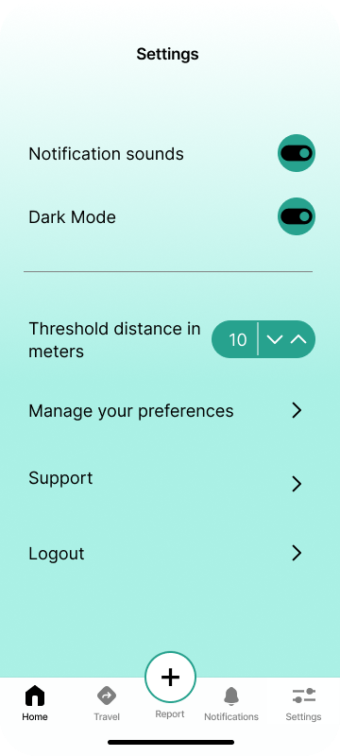
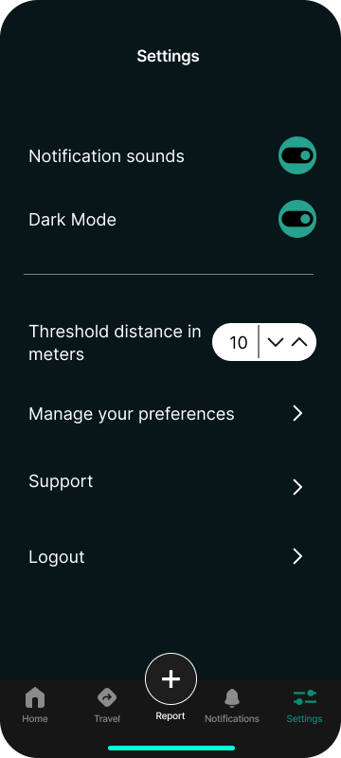
Preferences
Notifications
Themes
Units

Slide 18
03
Implementation of Design
This was done using React Native

Slide 19
Libraries and Components
Navigation
Maps
Markers
Use a navigation library like react-navigation to manage different screens within the app.
Integrate a mapping library like Mapbox or Google Maps to display the user's location and surrounding area.
Utilize marker components provided by the mapping library to highlight detected road signs on the map.

Slide 20
Libraries and Components
Icons
Cards and Panels
Text and Images
Utilize icon libraries like Material Icons or Font Awesome to represent road signs and road state information.
Implement components like View and Card from React Native to display sign information and road state overlays.
Use basic components like Text and Image to display information and sign images.

Slide 21
04
Conclusion
No System is Perfect! treat every every iteration as a prototype.

Slide 22

Thanks!
Do you have any questions?
Github: github....

